Slide 1

https://www.uni-goettingen.de/en/48115.html
UNPLAB-BrMeth_Ch-5[RecSel I]
Recurrent Selection I
1

Slide 2
Sequential Number: #23
UNPLAB-BrMeth_Ch-5[RecSel I]
Unless I explicitly state otherwise, images and cartoons are created using ChatGPT.
You may use this material free of charge under the terms of the CC BY license. This requires that you provide appropriate attribution to the author: W. Link, University of Goettingen, Germany.
In a few cases, individual images, photographs, or similar material may be subject to a more restrictive Creative Commons license. Where this applies, it is explicitly indicated, and you must comply with the stated license terms for those items.
Please check the license information carefully before reuse. Responsibility for complying with the applicable license terms rests entirely with you.
In case you have arrived here without any prior information: This is a chapter from a series of chapters, intended as learning modules for the agricultural subject of Plant Breeding, at the level of a scientific Master's degree. There are no credits and no guarantees, and you - yourself - are responsible for what you take away, what you learn, and how you deal with content, form, shape and mood ;-)
© Wolfgang Link, Göttingen, Germany, 2025
2

Slide 3
You already know:
Population Genetics. This mean pertinent items and topics such as
Genotype frequency, Allele frequency, Hardy-Weinberg-Equilibrium, Inbreeding coefficient,
Kinship (this one, for instance, find it in „PopGen_Ch-3“, in about page 29 there); Selection, Drift, Migration, Mutation.
You know what Plant Breeding essentially is, for instance, you know the difference between producing certified seed for farmers and breeding a candidate cultivar. You know about Heterosis and about Inbreeding. You know about Broad Sense Heritability, and as well the Breeder’s Equation and: How to predict Gain from Selection.
You know ‘General Combining Ability’ and ‘Specific Combining Ability’.
Are you interested, I mean, do you know enough about ‚Farmers‘ rights‘ and ‚Breeders‘ right‘?
Read more than one statement, so that you look beyond any current filter bubble (echo chamber)
https://www.seedworld.com/europe/2023/12/18/plant-breeders-rights-fact-from-fiction-2/
https://grain.org/fr/article/5142-seed-laws-that-criminalise-farmers-resistance-and-fightback
No Algebra in this Chapter
3

Slide 4

https://www.uni-goettingen.de/en/48115.html
How do we breed?
This question leads to method, techniques, approaches. It leads to Methodology. Developments and results apply to several or many cases (species, traits ...).
What do we improve?
This question leads to specific traits of specific species. ‘Specific Plant Breeding’; topics are specific, sometimes unique, often applicable for just one species or one trait.
4

Slide 5
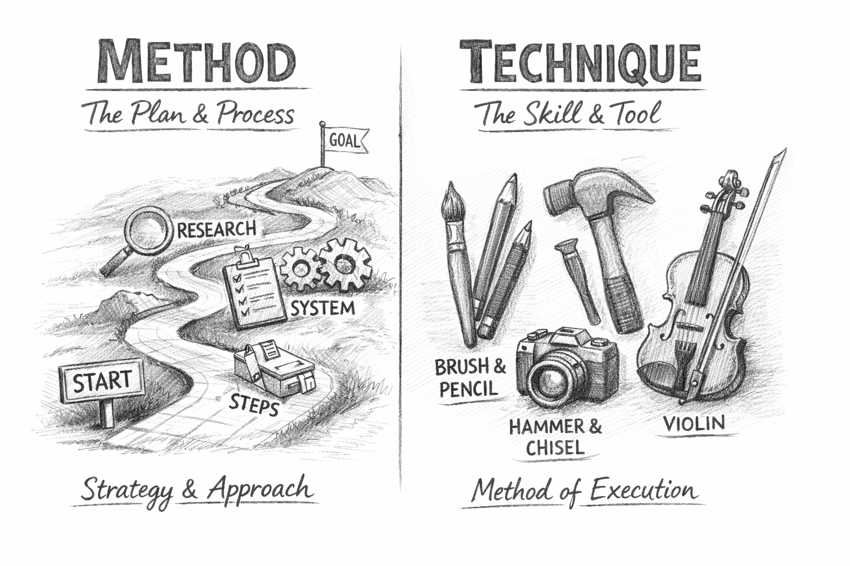
ChatGPT’s response when asked to illustrate Method vs. Technique.
Single-Seed Descent is, for instance, a Breeding Method in the Category of Line Breeding. It could as well be employed in the Line-Breeding phase of Hybrid Breeding.
Interspecific crossing, ploidy change, genome editing, increase of generations per year, micro-spore culture and DH production, yield prediction based on NIRS or genomic data, exploitation of He-terosis, employment of the con-cept of ‘Usefulness of crosses’ and more: These are not Methods in the current sense; they can be employed in more than one Ca-tegory. Name-them ‘Techniques’ ...
5

Slide 6
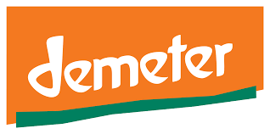



Examples for various insti-tutions in the field of Plant Breeding.
They follow different principles, philosophies, ideas.
Few follow Rudolf Steiner. Main stream is Gregor Mendel, Ronald A Fisher, Rex Bernar-do, PDS Caligari. https://s.gwdg.de/etU5Da
Logo always the property of the respective organisation: Here & once & for all!
Yet. With all the differences, Recurrent Selection is a good topic to find common tools and strategies of pre-scientific, conventional, anthroposophical, biological-dynamic, Goethe-anic, participatory, formal ... etc ... Plant Breeding.
And to find common understanding of Animal Breeding, Horticultural, Viticultural, Silvicultural, and Agricultural Plant Breeding.
ISBN 978-3-8322-7979-0
6

Slide 7
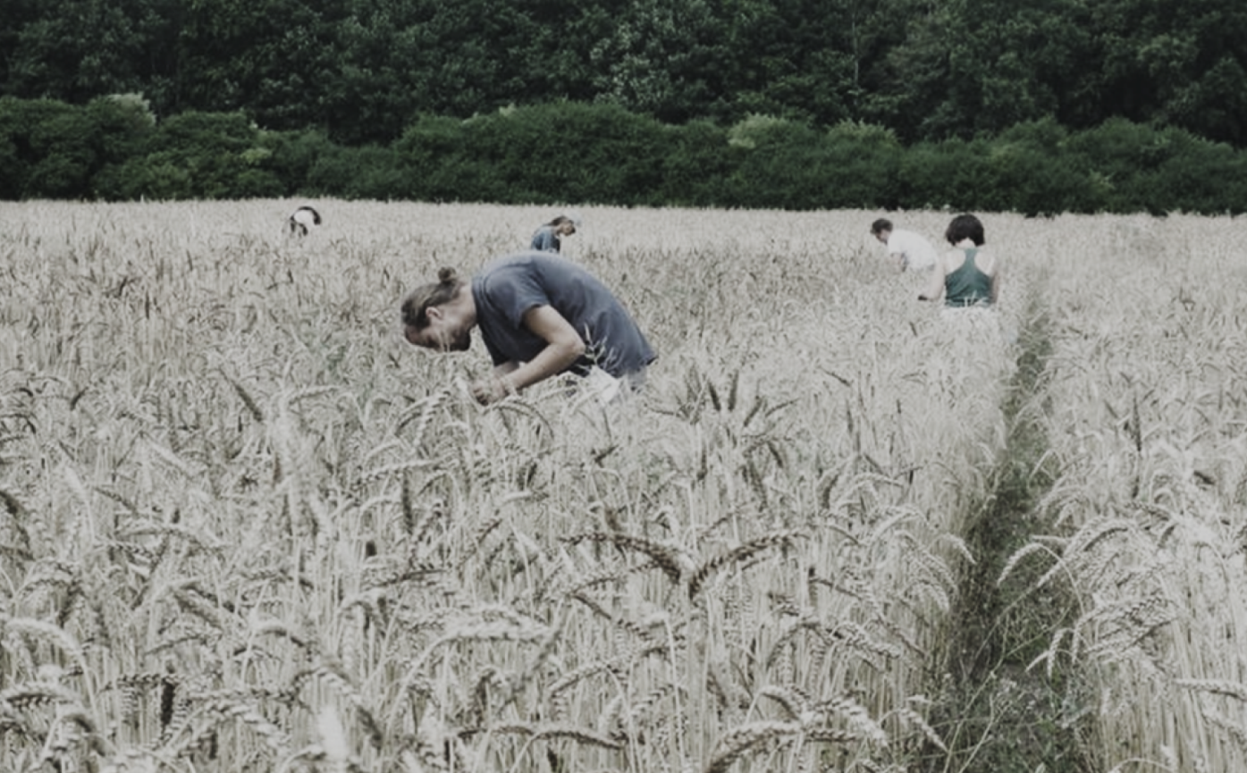
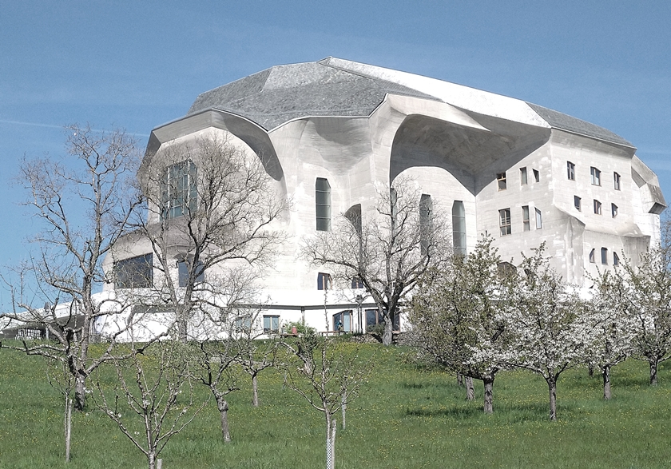
Left: Goetheanum in Dorchnach CH. Centre of the Anthroposophical Philosophy and Apprenticeship of Rudolf Steiner and (right) work in the wheat breeding nursery at Darzau (Goethanic breeding program of KJ Müller; www.cultivari.de).
© KJM, Darzau
© wlink 2026
7

Slide 8
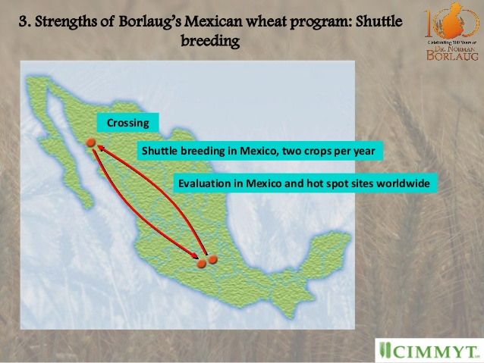
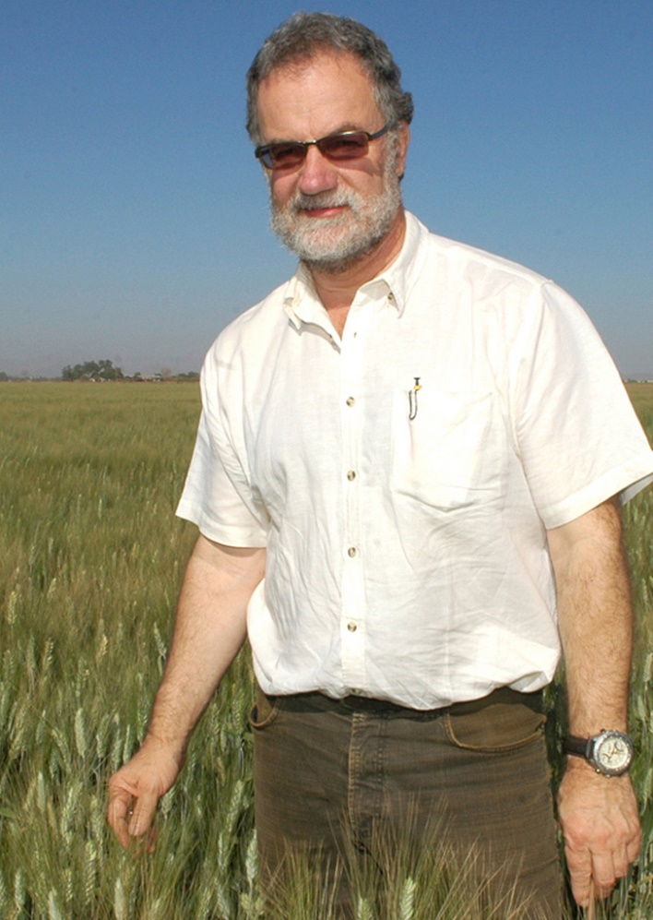

Cornerstones of CIMMYT's breeding methodology are wide adaptation, the use of a diverse gene pool for crossing, shuttle breeding, multi-locational testing. This strategy is similar to core breeding operations in Demeter breeding programs.
(https://edepot.wur.nl/312216).
https://www.dw.com/en/wheat-demand-is-growing-faster-than-other-staples/a-16294038
40m
2240m-2650m
Meters above sea level
HJ Braun, CIMMYT wheat breeder.
© CC-BY-SY-CIMMYT
https://pt.slideshare.net/CIMMYT/norm-and-i-dr-thomas-a-lumpkin; modified.
8

Slide 9
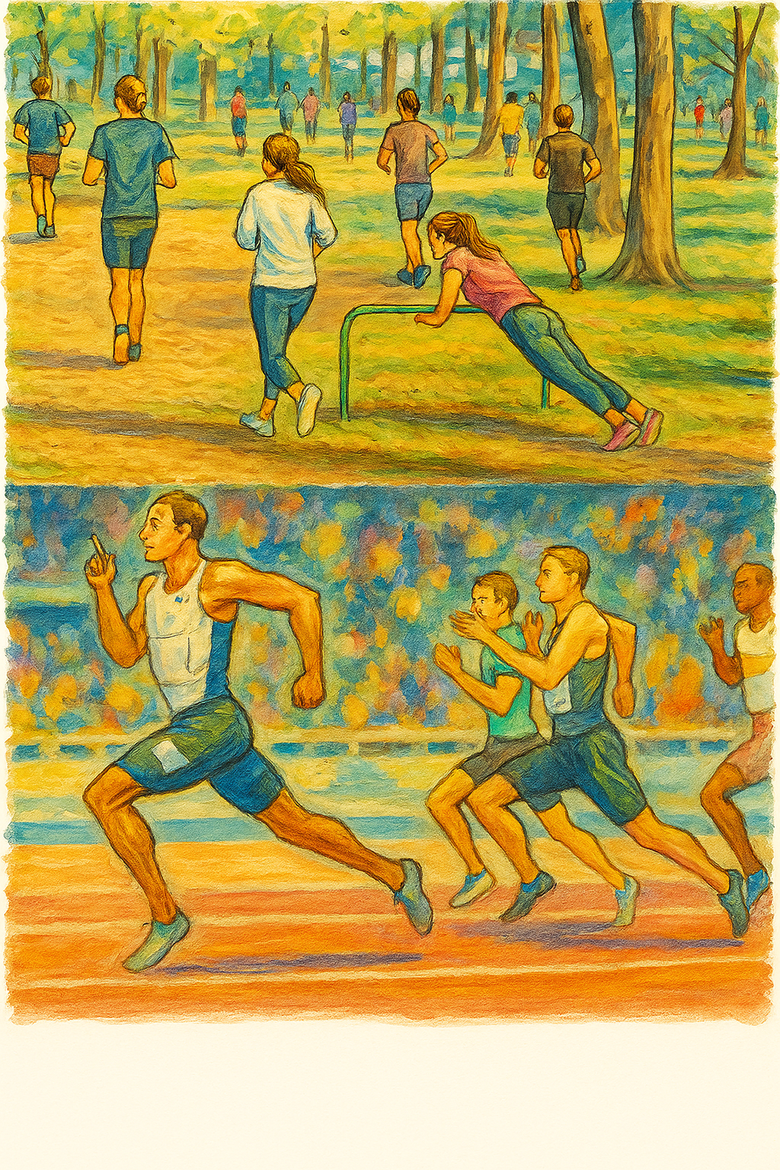
Mass sport (popular sport) and Pre-Breeding (Vorlaufzüchtung) have something in common:
Many participants, high diversity in performance. Recurrent selection can usually be considered as Pre-Breeding.
Sport contest and cultivar development have some-thing in common:
Elite level, fewer participants, smaller diversity in performance.
9

Slide 10
10
‘Recurrent Mass Selection’ in an annual, cross-fertilizing species is a smooth entrance into the topic Breeding ‘Scheme’;
or maybe you name it ‘Breeding Protocol’. Or maybe
‘process chart’, ‘schedule’, ‘work flow’ ?
We name it ¡‘METHOD’.
‘Mass selection’ ... Somewhat similar to natural selection; traditionally based on phenotype, meanwhile supported by DNA-data (e.g. Marker-assisted and Genomic Selection).
‘Cross-fertilizing’ ... near to the reference settings of ‘random mating’ and ‘Hardy-Weinberg-Equilibrium’.

Slide 11
[I] Recurrent Mass Selection. Start with a genetically diverse yet adapted Base Popula-tion, high number of individuals. Allow natural cross-fertilization. Select between indivi-duals, join (bulk-harvest) their seed, sow next generation from bulked seed.
Repeat (cycles). ...
Bulk seed harvest of selected individuals
Bulk seed harvest of selected individuals
Bulk seed harvest of selected individuals
et cetera
Extract population cv.
Cultivar
11

Slide 12
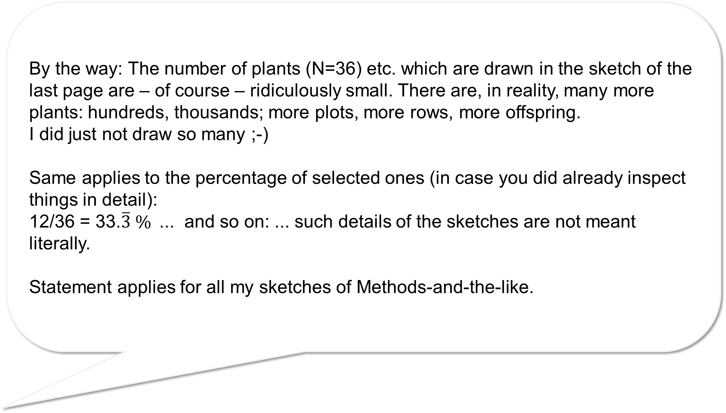
By the way: The number of plants (N=36) etc. which are drawn in the sketch of the last page are – of course – ridiculously small. There are, in reality, many more plants: hundreds, thousands; more plots, more rows, more offspring.
I did just not draw so many ;-)
Same applies to the percentage of selected ones (in case you did already inspect things in detail):
12/36 = 33.$\overline{3} \%$... and so on: ... such details of the sketches are not meant literally.
Statement applies for all my sketches of Methods-and-the-like.
12

Slide 13
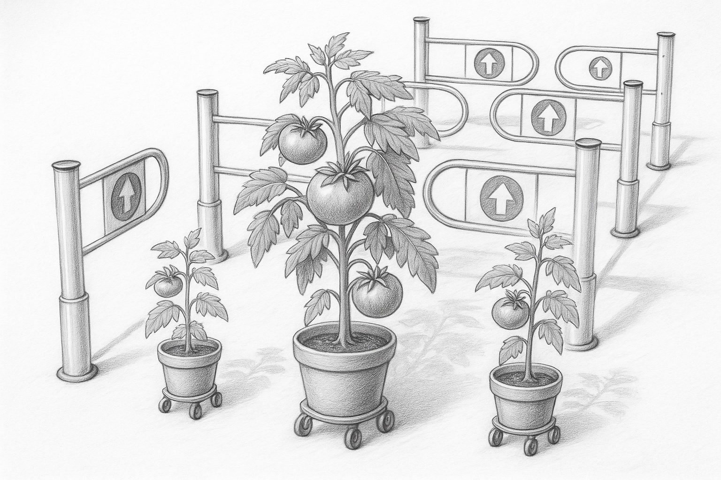
Sketch of Recurrent Mass Selection. Select across several cycles.
et cetera
Let them through or not
13

Slide 14
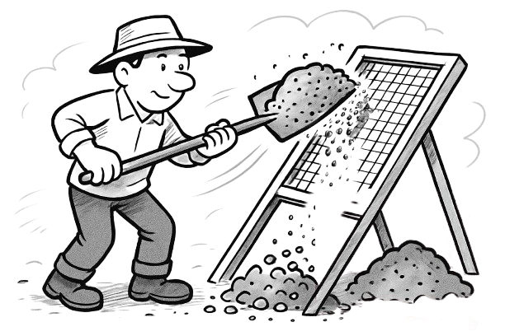
Sketch of Recurrent Mass Selection. Select, sift, cull, sort, define a filter, a threshold.
Visualize the sifting-aspect: Like to separate sand from gravel, using a sieve and muscle power.
et cetera
14

Slide 15
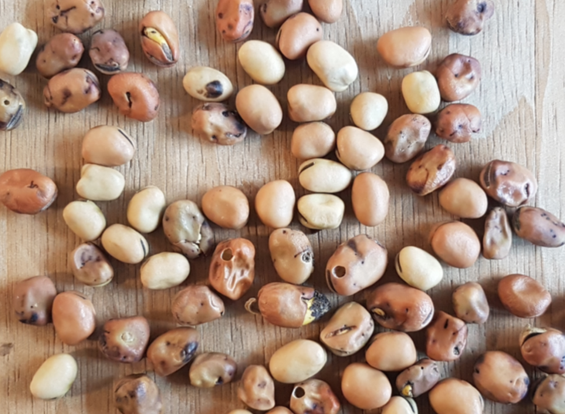
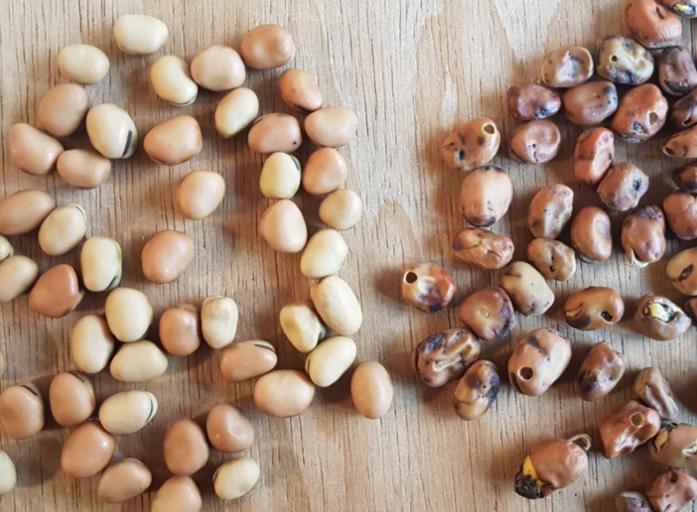
Sketch of Recurrent Mass Selection. Probably in the first millenniums such selection was mainly female work.
“Die Guten ins Töpfchen, die Schlechten ins Kröpfchen”. Aschenputtel.
Grimms Märchen.
The good ones go into the pot, the bad ones go into your crop. Cinderella. Grimm’s fairy tales.
et cetera
© SY & SW
15

Slide 16
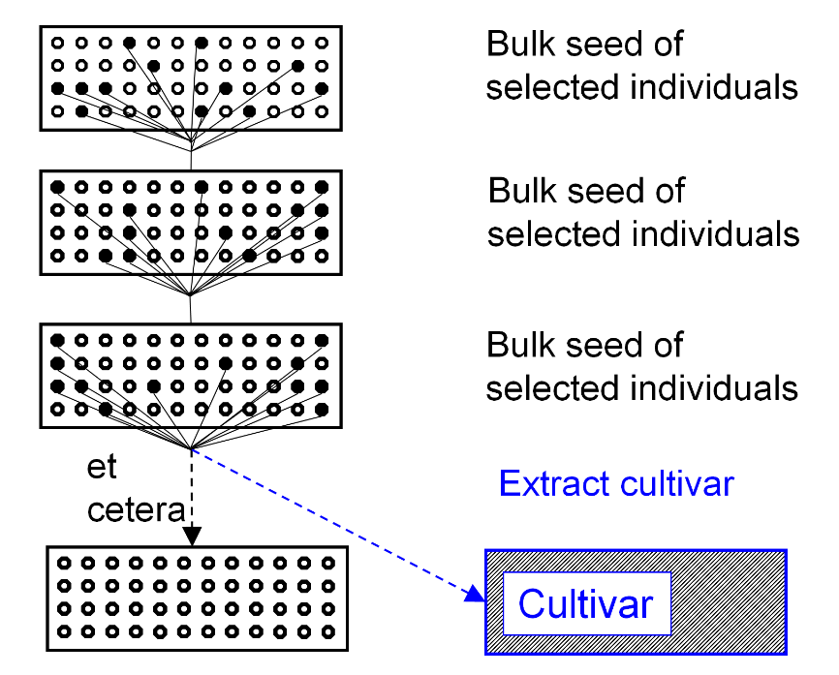
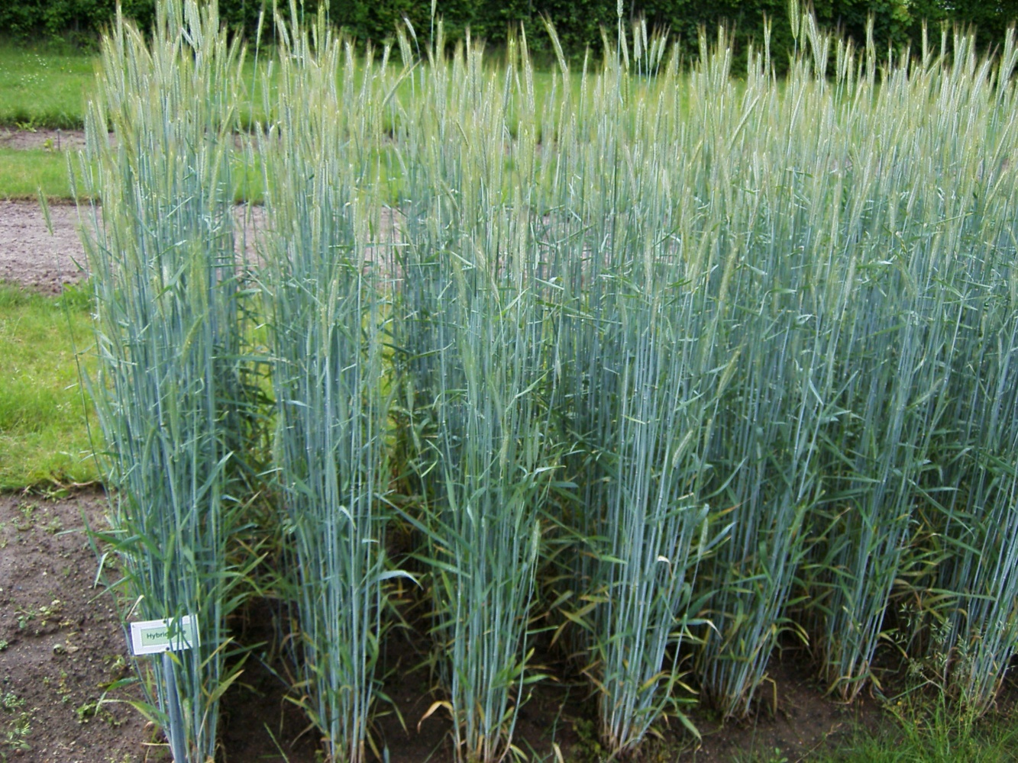
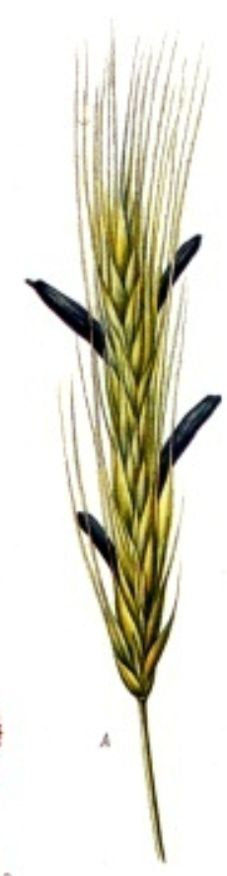
Sketch of Recurrent Mass Selection.
16
Select before flowering?
Recurrent Mass Selection against winter kill in red clover (Trifolium pratense ☘) would be before flowering. No winter-killed plant (genotype) would be able to ‘contaminate’ the next generation with its pollen (with alleles that code for winter-cold susceptibility). 
Select after flowering? Recurrent Mass Selection against ergot (Claviceps purpurea) infestation in rye (Secale cere-ale) would be after flowering, and the more susceptible plants (genotypes) would indeed have the opportunity to pollinate (fertilize) later-on selected plants, thus diluting our gain from selecting (seed of) the better plants for next cycle. 
Claviceps purpurea on rye. Franz Eugen Köhler, 1897.
Hybrid rye cv. ‘Esprit’ (KWS) in 2010. © W. Link

Slide 17
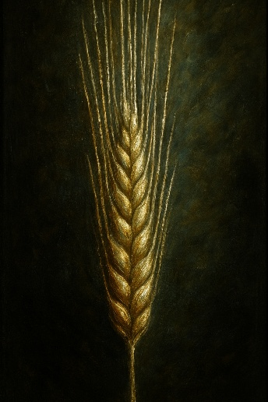
Sketch of Recurrent Mass Selection. The so-called ‘Dilution of the Soup’.
Select before or after flowering? After flowering means: We do not avoid fertilizations of the ‘good-ones’ with the many (finally) discar-ded ‘bad-ones’. This means that a ‘Dilution of the Soup’ takes place.
Further questions. Phenotypic selection? DNA-based selection? On which trait to select? Will phenotypic selection on (error-prone) single-plant data lead to adequate gain from selection?
Can we have more than one selection step per calendar year, or per season?
How to reconcile hard selection & maintenance of genetic diversity? ... so, how to minimized Drift and Inbreeding?
For the sake of long-term gain from selection, diversity must be spared, must be kept high, little scathed, protected from decay (geschont).
At which cycle(s) of recurrent selection do we extract material to create a candidate cultivar (i.e., enter breeding;
and then, how?).
17

Slide 18
Recurrent Selection is a cyclic, stepwise process. Same procedure each cycle. Gain genetic progress per cycle. From each cycle you may extract a cultivar or components for a future cultivar. Theoretically, the genepool is closed: No alien genetic material is introduced. Yet, in practice, breeders typically behave opportunistic and adapt their schemes.
Cycle 2
Cycle 1
Selection units
Test units
Cycle 0
Selection units
Test units
Selection units
Test units
Recombination units
Gain
Recombination units
Recombination units
18

Slide 19
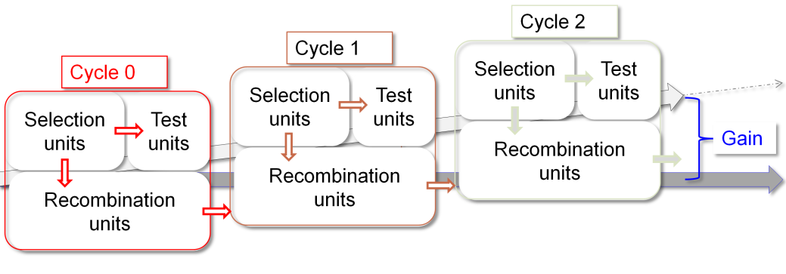
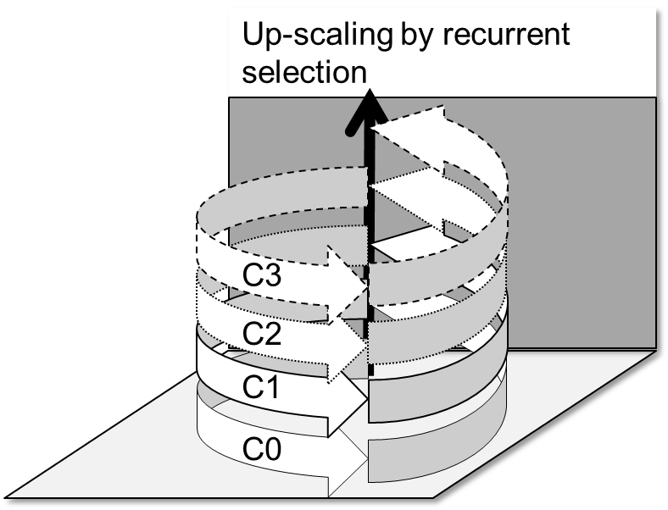
© wlink
Selection units: These are the individuals (genotypes) of the (Base)
Population (germplasm). Each cycle starts with a new generation,
from the recombination (sexual propagation) of the last cycle.
Test units: The Test units may be the Selection units. Yet, if the individuals are not assessed directly (not themselves) but indirectly, via testing their offspring (from selfing or crossing the Selection units), then these offspring are the Test units.
Recombination units: If recombination is not done as crossing among the selected individuals, but instead their offspring genotypes are recombined (crossed among each other), then these offspring are the Recombination units.
19

Slide 20
Here, altogether 8=VIII methods of recurrent selection will be presented.
You studied already number 1 as [I] Recurrent Mass Selection.
Next chapter starts with
[II] ‘Recurrent selection on highly heritable traits*, such as oil quality in sunflower (e.g. ‘high-oleic-low-linolenic oil’ types of sunflower).
*aka “Recurrent Selection on phenotypic traits”
(a slightly strange term imho).
*https://s.gwdg.de/GDIIXp
20

Slide 21
From here you may go to UNPLAB-BrMeth_Ch-6[RecSel II]
© SY & SW
21
21

